Slide 1
Details
Ministry/ Organization name:
Ministry of Health and Family Welfare
Team Name :
SEM_ALPHA
Problem Statement ID
SS-42
Vinit Masrani

Slide 2
Problem Statement
Health care systems may be overstretched, and public order may be threatened. Hence the use of social media in public health emergency response.
Such tool/page/plugin should have below capabilities:
(1) Alarm message during emergencies.
(2) Providing Precautionary steps to be taken during emergency/disasters.
(3) Help in finding nearby available healthcare systems.
(4) Providing First aid/primary steps to be taken/provided to patients, in case of emergencies/disasters.
Problem Statement:
Emergencies and disasters impact population health.
Public health plays a critical role in working with health and non-health sectors responsible for preparing and responding to emergencies.
In emergencies, large numbers of people may require medical attention.

Slide 3
What we want to achieve?
Alert about disasters and provide first aid and precautionary steps through social media (offline and online)
Multitude of people
Save lives
Use social media for:
1) Proactive approach and preparedness by disaster forecasts (Pre-disaster)
2) Disseminate genuine news to people and emergency aid (In-disaster)
3) Provide precautionary measures and donation means (Post-disaster)
4) Minimal human intervention

Slide 4
Solution overview
1) The aim of our project is to reach the masses immediately so as to alert them about the emergencies and disasters to take action promptly.
2) The latest news is scraped from the leading news websites.
3) The news is classified into disaster relevant news or irrelevant news.
4) Then, the disaster relevant news is classified into disaster type:
Floods, earthquakes, wildfire, pandemic, storms and violence.
5) Other fields related to the news is extracted like:
description, location, date, URL to news, URL to image
6) These news in form of alerts are sent through social media platforms along with disaster forecasts like website, plug-ins, mobile application, advertisements, SMS and email.
7) Accordingly, the preventive and first aid measures are shown on the tool and healthcare centers are exhibited for people along with donation provisions.

Slide 5
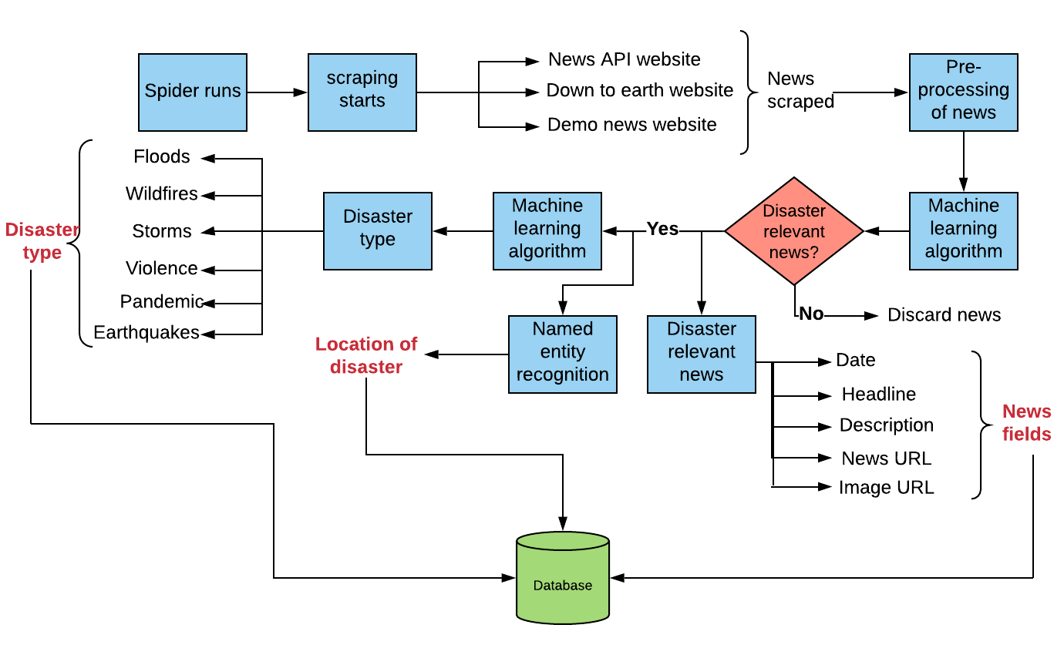
Block Diagram

Slide 6
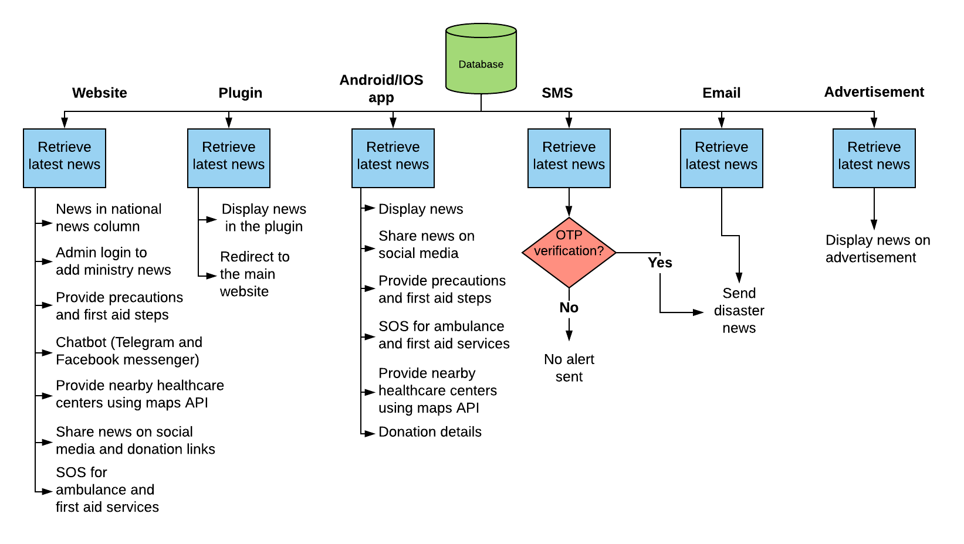
Block Diagram

Slide 7
Flow of Website + Plugin
User in the Disaster Zone
User out of Disaster Zone
Disaster occurred -> Person is stuck and needs help -> Person opens the website and click on SOS button for sending alert to the nearby health centres -> Person is injured also -> So opens the Chatbot and gets first aid steps/views the first aid steps page -> In the meantime, health services arrive
Disaster occured -> Person gets notification through Plug-In -> Plugin redirects to Website -> He is unable to read English -> Change to Local Language -> Person views the news -> And then the Person shares the news on social media -> And makes the donations if interested to relief funds -> also views disaster forecast to be prepared before crisis

Slide 8
Flow of Android App
User in the Disaster Zone
User not in the Disaster Zone
User is stuck inside the disaster zone -> User needs emergency services -> User sends SOS alert to the near ones -> The User is also bleeding -> And goes to first aid section of the App -> And gets the steps and heals himself temporarily -> Hospital reaches to User after the alert message is sent
User near one is stuck in the Disaster -> The User gets SOS message of the near ones and where he’s stuck along with nearby Hospital contact -> User contacts the hospital and alerts them -> And then the user goes through the app to see the news -> User also shares the news with others over the social media platform -> User does the donation

Slide 9
Flow of Advertisements
The User is on the social media where the ad is deployed -> He sees about the disaster that has occurred through the Ad and immediately clicks on it -> User is redirected to the Website -> He sees the news in detail -> Makes donation if interested -> And while surfing on the website he sees the Pre-Disaster alert -> And sees the warning of Disaster going to happen in his location -> User Gets alerted about it -> User then visits the Precautions sections on website of that disaster -> User prepares himself

Slide 10
Flow of Chatbot
Consider User is there in Disaster zone -> User sees a person who is injured and needs the first aid urgently -> But User doesn’t have any knowledge about the first-aid steps -> User connects to the Chatbot either through Website or App or Facebook Messenger or Telegram -> User types in his query to get first aid for injury -> User gives First-aid to person and person is relieved

Slide 11
Technology stack
01
Tools used:
1) Requests python library
2) Beautiful soup python library
3) Crontab scheduler
Why these tools were used:
1) Lightweight
2) Fast
3) Efficient for parsing HTML
4) Comprehensive documentation
Scraping
02
Tools used:
1) Scikit-learn python library
Why the tool was used:
1) Accessibility and simplicity
2) Useful utilities
3) Good documentation
4) Consistent API
Machine Learning to Detect Disaster Relevant News

Slide 12
Technology stack
03
Tools used:
1) Scikit-learn python library
Why the tool was used:
1) Accessibility and simplicity
2) Useful utilities
3) Good documentation
4) Consistent API
Machine Learning to Classify News into Categories
04
Tools used:
1) spaCy library
Why these tools were used:
1) Fast and accurate
2) Ready access to word vectors
3) State-of-the-art accuracy
4) Powerful and concise API
Named Entity Recognition for Location Extraction

Slide 13
Technology stack
05
Tools used(Back-End):
1) Django
2) Firebase
Why these tools were used:
1) Accelerates custom web application development
2) More functionality out of the box
3) Smart security defaults
Tools used (Front-end):
1) HTML
2) CSS
3) Javascript
Why these tools were used:
1) Efficient
2) Wide documentation
Website
06
Plug-in
Tools used:
1) Rich notification API by Google
2) Firebase
Why the tool was used:
1) Create notifications using templates
2) Dynamic event listener

Slide 14
Technology stack
07
Tools used:
1) Fast2sms API
2) Inbuilt django utility (django.core. mail)
Why these tools were used:
1) SMS API is fastest and simplest
2) SMS API sends bulk messages
3) Django utility is easy and efficient to connect
SMS and Email
08
Tools used:
1) Flutter by Google
2) Firebase by Google
Why the tool was used:
1) Cross platform
2) Compatible to all OS versions
3) Support for firebase
4) Firebase is real time database
5) Firebase authentication
Mobile Application

Slide 15
Technology stack
09
Tools used:
1) Dialog Flow
2) GCP
Why the tool was used:
1) Integration is easier
2) Training takes less time as supported by Cloud
Chatbot
10
Tools used:
1) HTML Templates
Why the tool was used:
1) They provide easy integration with the website we want to register the ads with
Ads

Slide 16
Why our solution?
1
1) All components in one platform: latest news, ministry news, disaster forecast, maps, precautions, first aid, donations, chatbot, SOS button
2
2) User friendly UI
3
3) OS compatible (Android and IOS) and cross platform (website, plug-in , mobile app)
4
4) Minimal human intervention

Slide 17
Conclusion
Thus, We successfully made the system which can reach out to masses before, during and after disaster achieving disaster management through various platforms providing various different services and thus fulfilling the objective.

